Slide 1

THE ECONOMIC BENEFITS OF
KEEPING THE “E” IN EBS:
A COMPARISON OF LICENSING UNASSIGNED EBS
TO EDUCATORS AND NONPROFITS VS. COMMERCIAL AUCTIONS
Telecom Advisory Services, LLC
Washington DC, May 15, 2019

Slide 2
APPROXIMATELY 4,000 EBS LICENSES , PRIMARILY IN RURAL PARTS OF THE COUNTRY, HAVE NEVER BEEN ASSIGNED
CURRENT EDUCATIONAL BROADBAND SERVICE LICENSES
Source: FCC Universal Licensing System Data

Slide 3
PURPOSE OF STUDY:
ASSESS THE ECONOMIC AND SOCIAL VALUE OF EXTENDING THE CURRENT LICENSING REGIME
The FCC is considering various proposals for licensing the remaining 4,000 EBS licenses (“EBS white space”)
This study considers two proposals:
  A baseline proposal would assign the remaining licenses to educational organizations and/or tribal nations, as it was done before
  As an alternative, others propose that remaining EBS white space be auctioned to commercial providers while simultaneously eliminating all requirements that this spectrum is used for educational purposes
The FCC also recommends that current EBS licensees be allowed to sell their licenses to commercial operators
KEY STUDY ISSUES
What is the economic and social value of extending the current EBS licensing regime to educational institutions/tribes?
What comparable value would be generated if the licenses are auctioned to commercial operators instead?

Slide 4
THE STUDY IS BASED ON ESTIMATING SOCIO-ECONOMIC TRADE-OFFS OF ASSIGNING ~4,000
2.5 GHZ LICENSES THROUGH EITHER CURRENT EBS RULES OR AN OVERLAY AUCTION
Existing EBS Licenses
Out of scope
Used only to derive benchmarks for modeling
~ 2,280 licenses
50% of US territory
85% of population
New EBS Licenses
~ 4,000 licenses
50% of US territory
15% of population
License to Educators Model
Auction Model
Economic benefit of reducing the population unserved by wireless broadband
Economic benefit of new, affordable EBS broadband offers in areas already served by commercial operators
Social benefit from the two effects above
Overlay auction proceeds for 4,000 licenses
Economic benefit based on commercial offers in new covered areas, considering ROI imperatives and timiming as constraints of deployment

Slide 5
SIX SOURCES OF SOCIAL AND ECONOMIC VALUE TO BE ASSESSED
Current Situation
Key question
Reduction of digital divide
Wireless broadband penetration: 85% (GSMA)
78 unserved counties and 141 partially served counties (Form 477)
Rural county coverage: 50% (Opensignal)
Which option more effectively reduces the digital divide?
Increase in GDP
Which option generates the largest externalities impacting the GDP?
US GDP $ 19.39 trillion (World Bank)
5,013,242 children under 18 years old no broadband subscription (ACS 2017)
2,036,753 children under 18 reside in a household without a computer (ACS 2017)
Which option has the highest reduction of the homework gap?
Reduction of homework gap
7.4% high school dropout rate (National Center of Education Statistics)
70% of high school graduates apply to college but 1 in 5 quit (Dept. of Education)
Which option has the highest impact on reduction of high school attrition?
Reduction of high school attrition
Economic Surplus
Most affordable LTE plan: $20(*) (3.5% of monthly income of first decile)
Public libraries use 266 GB per month, interested in saving in data consumption
Which option increases wireless broadband affordability?
Contribution to Treasury
What is the contribution to the Treasury of each option?
The FCC collected $21.267 billion in 2017-18 spectrum auctions
* Verizon Connected Device Ellipsis Hotspot service for US$ 20 monthly

Slide 6
ASSESSMENT OF OF ECONOMIC AND SOCIAL VALUE
Reduction of the digital divide
Contribution to GDP
Reduction of the homework gap
Reduction of high school attrition
Economic surplus
Contribution to Treasury

Slide 7
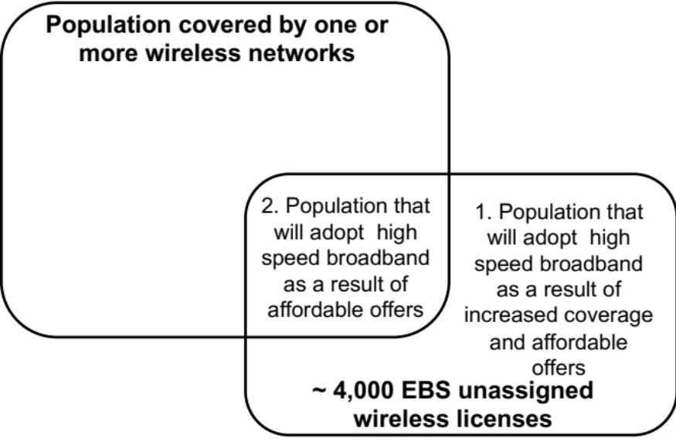
REDUCTION OF THE DIGITAL DIVIDE:
MODERNIZING THE EBS LICENSING MODEL COULD REDUCE THE DIGITAL DIVIDE BY ABOUT 18.28%
11,478,000 non-adopting population (*)
5,783,000 unserved population
Price elasticity of a $10/month plan (**)
Expected adoption: 58% (Pew Research)
5,002,000 subscribers
3,354,000 subscribers
8,356,000 new subscribers (18.28% reduction of digital divide)
* 15,852,000 population already purchasing service. (**) PER SHLB proposal

Slide 8
REDUCTION OF THE DIGITAL DIVIDE:
AUCTIONING UNASSIGNED EBS YIELD ONLY A 1.49% DIGITAL DIVIDE REDUCTION
11,478,000 non-adopting population (*)
5,783,000 unserved population
Commercial operators do not need spectrum to offer affordable plans
24 out of 78 counties present a positive NPV of Wireless deployment
0 subscribers
682,000 subscribers
682,000 new subscribers (1.49% reduction of digital divide)
* 15,852,000 population already purchasing service

Slide 9
ASSESSMENT OF OF ECONOMIC AND SOCIAL VALUE
Reduction of the digital divide
Contribution to GDP
Reduction of the homework gap
Reduction of high school attrition
Economic surplus
Contribution to Treasury

Slide 10
INCREASE IN GDP:
THE EBS LICENSING MODEL PRODUCES SIGNIFICANTLY GREATER IMPACT ON GDP
Additional subscribers / incremental penetration
GDP five-year cumulative impact
Keeping the current EBS license framework
8,356,000 ( 2.70%)
$70.93 billion
An increase of 10 percent in penetration yields an increase in 0.1156 % of the GDP (ITU model)
Assigning licenses through an overlay auction
682,000 ( 0.22 %)
$4.94 billion

Slide 11
ASSESSMENT OF OF ECONOMIC AND SOCIAL VALUE
Reduction of the digital divide
Contribution to GDP
Reduction of the homework gap
Reduction of high school attrition
Economic surplus
Contribution to Treasury

Slide 12
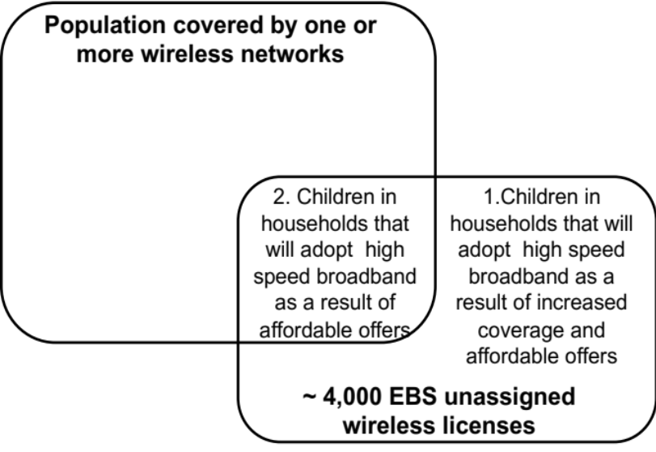
REDUCTION OF THE HOMEWORK GAP:
THE MODERNIZED EBS LICENSING MODEL COULD REDUCE THE RURAL HOMEWORK GAP BY ABOUT 29.6%
Homework Gap
In Rural Areas with
Unassigned EBS:
662,000
87,450 children
144,000 children
85% of non adopters would acquire affordable plan of $10/month (*)
85% adoption of affordable plan of $10/month (*)
73,000 children
123,000 children
196,000 children (29.6% reduction of homework gap in rural areas)
(*) PER SHLB proposal

Slide 13
REDUCTION OF THE HOMEWORK GAP:
COMMERCIAL-LED HOMEWORK GAP PROGRAMS WILL REDUCE THE RURAL HOMEWORK GAP BY 1.13%
Homework Gap
In Rural Areas with
Unassigned EBS:
662,000
87,450 children
144,000 children
24 of 78 counties present a positive NPV of Wireless deployment enabling the offer of One Million
Sprint does not need additional spectrum to offer One Million plan in these areas
0 children
One Million restricted to high school students: 7,500 children
7,500 children (1.13% reduction of homework gap in rural areas)

Slide 14
ASSESSMENT OF OF ECONOMIC AND SOCIAL VALUE
Reduction of the digital divide
Contribution to GDP
Reduction of the homework gap
Reduction of high school attrition
Economic surplus
Contribution to Treasury

Slide 15
REDUCING HIGH SCHOOL ATTRITION:
THE EBS LICENSING MODEL COULD INCREASE HIGH SCHOOL GRADUATION FOR 43,047 CHILDREN
Total K-12 children in rural counties: 4,415,000
Total high school dropout in rural counties:
326,700 (*)
4,467,165 children
935,857 children
1.62% elasticity household penetration
Children with access 6-8 percentage points more likely to graduate (Beltran et al.)
58% household penetration
Children with access 6-8 percentage points more likely to graduate (Beltran et al.)
5,051 children
37,996 children
43,047 children (13.17% decrease in high school dropout)
* Total K-12 children * 7.4% High school dropout rate

Slide 16
REDUCING HIGH SCHOOL ATTRITION: THE PROVISION OF BROADBAND TO SCHOOLS
COMBINED WITH HOT SPOT LENDING COULD INCREASE GRADUATION FOR 23,778 CHILDREN
Total K-12 children in rural counties: 4,415,000
Total high school dropout in rural counties:
326,700 (*)
15,619 schools served
3,676 schools served
58% household penetration
Children with access 6-8 percentage points more likely to graduate (Beltran et al.)
Schools already served by broadband; thus no incremental effect
0 children
23,778 children
23,778 children (7.28% decrease in high school dropout)
* Total K-12 children * 7.4% High school dropout rate

Slide 17
REDUCING HIGH SCHOOL ATTRITION:
COMMERCIAL-LED PROGRAMS WILL INCREASE HIGH SCHOOL GRADUATION FOR 1,583 CHILDREN
Total K-12 children in rural counties: 4,415,000
Total high school dropout in rural counties:
326,700 (*)
4,467,165 children
935,857 children
Sprint does not need additional spectrum to offer One million plan in served areas
24 out of 78 counties present a positive NPV of Wireless deployment enabling the offer of One Million
One Million restricted to High school students
0 children
1,583 children
1,583 children (0.48% decrease in high school dropout)
* Total K-12 children * 7.4% High school dropout rate

Slide 18
ASSESSMENT OF OF ECONOMIC AND SOCIAL VALUE
Reduction of the digital divide
Contribution to GDP
Reduction of the homework gap
Reduction of high school attrition
Economic surplus
Contribution to Treasury

Slide 19
MEASURING ECONOMIC SURPLUS:
THE EBS LICENSING MODEL WILL YIELD AN ECONOMIC SURPLUS OF $ 158.31 MILLION
Households that would pay US $10 instead of US $20 for broadband
    583,457 households affected by new competition
    85% adoption
Annual savings by purchasing a cheaper plan per household
    $120
Consumer surplus
Annual savings
    $59.68 million
X
=
Institutions in areas already served by commercial operators
    K-12 schools: 12,114
    Post-secondary schools: 720
    Libraries: 2,785
Annual prorated broadband savings by purchasing from non-profit operator
    $1,263
Producer surplus to anchor institutions
Five year savings
    $98.63 million
X
=

Slide 20
ASSESSMENT OF OF ECONOMIC AND SOCIAL VALUE
Reduction of the digital divide
Contribution to GDP
Reduction of the homework gap
Reduction of high school attrition
Economic surplus
Contribution to Treasury

Slide 21
CONTRIBUTION TO THE TREASURY:
OVERLAY AUCTION PROCEEDS OF THE EBS LICENSES IS ESTIMATED AT $52.25 M (*)
AVAILABLE SPECTRUM
AVAILABLE MHz/POP
 | Rural counties | Non-rural counties | Total
>100 MHz | 392 | 38 | 430
99 - 70 MHz | 215 | 75 | 290
69 - 50 MHz | 6 | 5 | 11
49 - 30 MHz | 83 | 62 | 145
29 - 10 MHz | 186 | 122 | 308
<10 MHz | 10 | 4 | 14
Total | 892 | 306 | 1,198
MHz per POP | Rural Counties | Non-rural counties | Total
Higher than 10 million | 2 | 13 | 15
9,999,999 – 5,000,000 | 22 | 43 | 65
4,999,999– 3,000,000 | 41 | 41 | 82
2,999,999 – 2,000,000 | 67 | 45 | 112
1,999,999 – 1,000,000 | 173 | 70 | 243
999,999 – 800,000 | 65 | 20 | 85
799,999 – 600,000 | 103 | 18 | 121
599,999 – 400,000 | 111 | 20 | 131
399,999 – 200,000 | 165 | 20 | 185
199,999 – 100,000 | 86 | 9 | 95
99,999 – 50,000 | 46 | 5 | 51
49,999 – 30,000 | 7 | 0 | 7
29,999 – 20,000 | 3 | 0 | 3
19,999 – 10,000 | 1 | 1 | 2
9,999 – 5,000 | 0 | 1 | 1
Lower than 4,999 | 0 | 0 | 0
Total | 892 | 306 | 1,198
AUCTION 86 is the most recent overlay auction of spectrum with similar characteristics and levels of license encumbrance. This yielded proceeds of $0.027 per MHz-pop
(*) Even if 2.5 GHz spectrum has tripled in value since 2009, total revenue would still be only $156.75 million

Slide 22
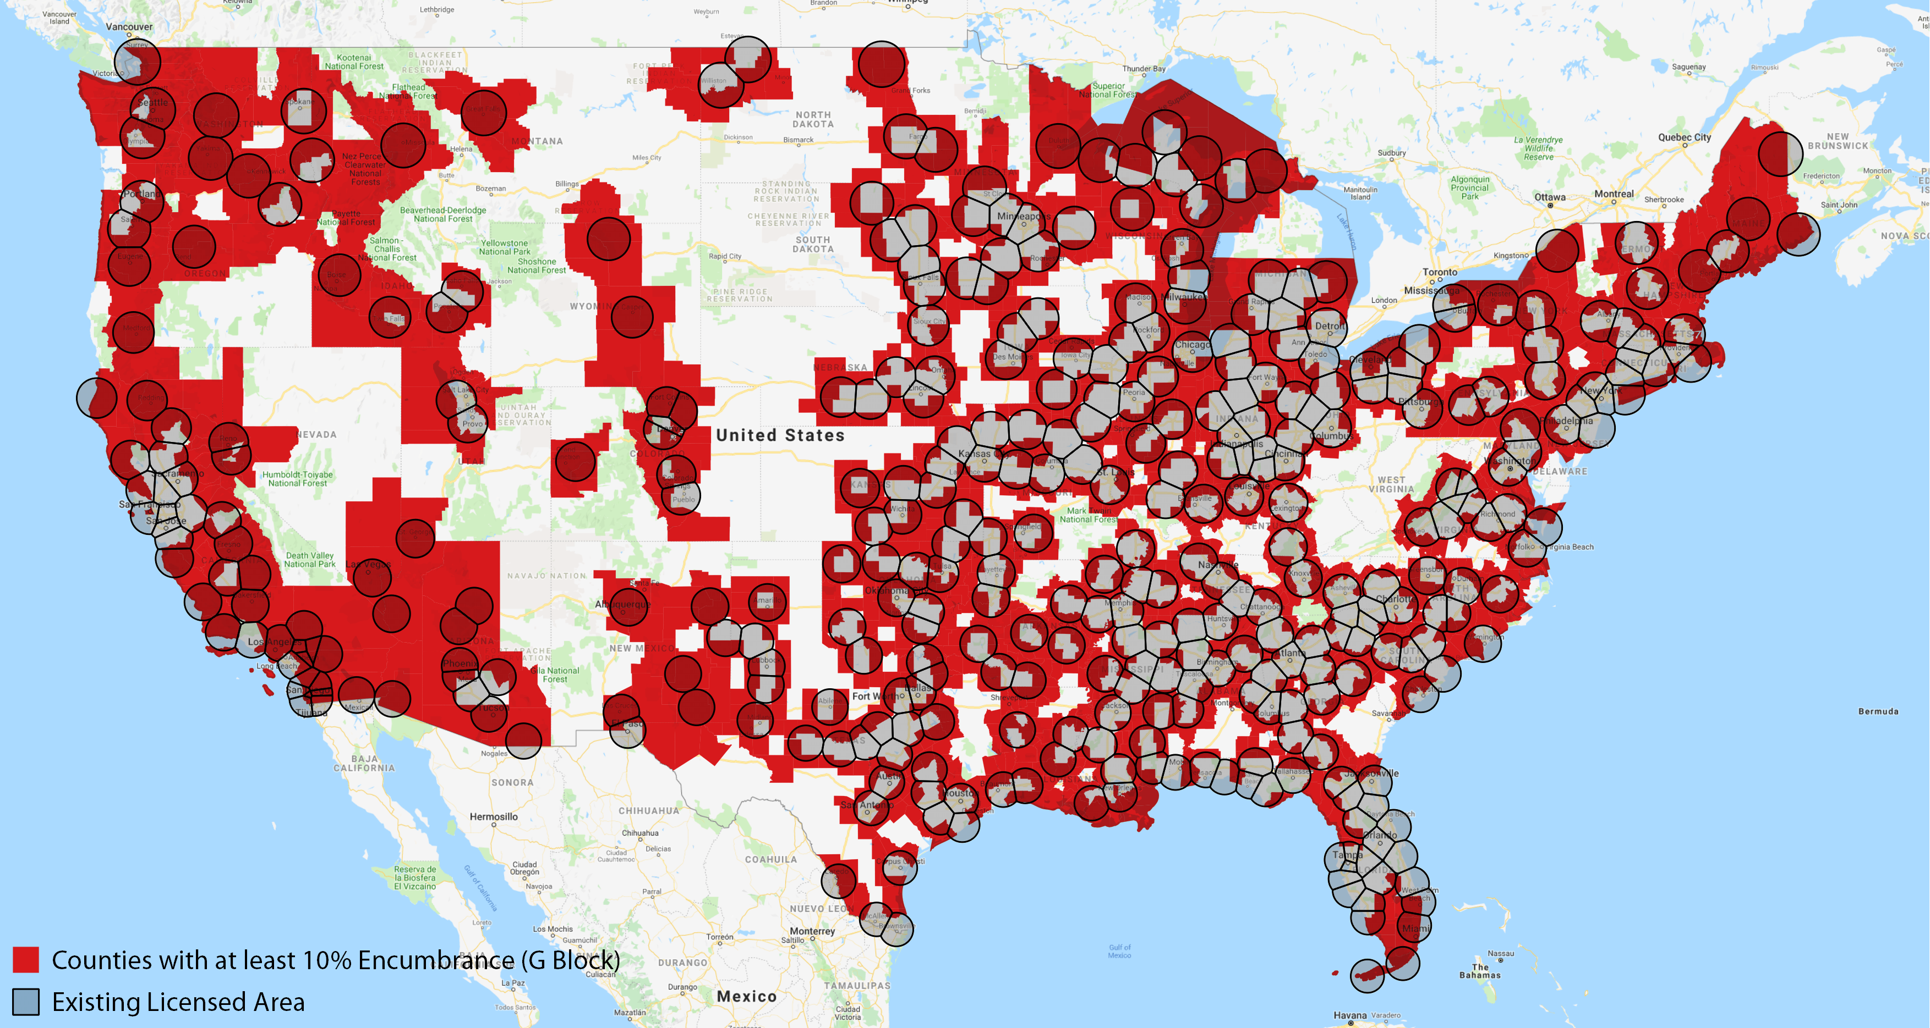
THE TYPICAL LICENSE WOULD BE HEAVILY ENCUMBERED IN ANY POTENTIAL OVERLAY AUCTION, WHICH RESULTS IN ARTIFICIALLY DEPRESSED PRICES DUE TO BIDDING ADVANTAGES FOR EXISTING INCUMBENT
LICENSE ENCUMBRANCE IN POTENTIAL EBS OVERLAY AUCTION
Source: FCC Universal Licensing System Data

Slide 23
COMPARATIVE ECONOMIC AND SOCIAL VALUE ANALYSIS SHOWS LICENSING EBS TO EDUCATORS AND NONPROFITS YIELDS GREATER BENEFITS THAN AUCTIONS
EBS Licenses
Overlay Auction
Reduction of digital divide
18.28% reduction in digital divide
8,356,000 new subscribers
1.49% reduction in digital divide
682,000 new subscribers
Increase in GDP
$ 70.93 billion from increased penetration
$ 4.94 billion from increased penetration
Reduction of homework gap
29.6 % reduction in rural homework gap
196,000 children
1.13% reduction in rural homework gap
7,500 children
Social effects
66,825 additional children graduating from high school
1,583 additional children graduating from high school
Consumer surplus from affordable offers: $59.68 million
Producer surplus for anchor institutions: $98.63 million
Consumer surplus from affordable offers: $0
Producer surplus for anchor institutions: $0
Economic surplus
Contribution to Treasury
$ 0
$ 52.25 million

Slide 24
WHY IS THE DIFFERENCE IN SOCIAL AND ECONOMIC VALUE BETWEEN OPTIONS SO SIGNIFICANT?
Wireless broadband deployment economics (not a lack of available commercial spectrum) constrain the development of network in rural, unserved counties.
  Additional spectrum will not change the economic constraints that disincentivize investment in sparsely populated areas
Commercial wireless carriers do not have an offer focused on increasing adoption by low income population [especially in rural areas]
Commercial-led homework gap offers (e.g. Sprint’s One Million plan) have limitations that comparable EBS offers do not (e.g. data caps and available only to high school students)
There is no commercial carrier offer comparable to EBS offers like those available from Mobile Beacon and Mobile Citizen, which focus on affordable service to anchor institutions (schools, libraries, nonprofits) and their users (such as hotspot lending models)
Proceeds of an overlay auction are limited due to significant encumbrances and the majority of unencumbered spectrum is limited to rural licenses, which generally yield lower proceeds than bids for spectrum in more populated areas

Slide 25
TELECOM ADVISORY SERVICES, LLC
For more information please contact:
Raul Katz, raul.katz@teleadvs.com, +1 (845) 868-1653
Telecom Advisory Services LLC
1349 West 82nd Street
New York, New York 10024 USA

