Slide 1

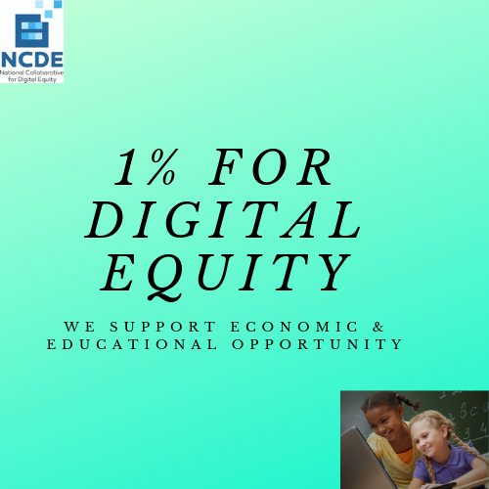

National Summit on Digital Equity & Economic Inclusion:
From Compliance to Impact
May 14-15, 2019
NEA
Washington, DC

Slide 2

Digital Divide Challenges to Economic & Educational Opportunity
Per Pew Research Center studies:
44% of households earning <$30,000 year lack home broadband
46% of these households lack a home computer
26% are “smartphone-dependent” even for homework and job applications where a full keyboard would boost productivity dramatically
24% of low-income households have only one Internet-capable device, compelling device sharing across all family purposes and potential users.
Meanwhile, employers almost universally rely on online job announcements and applications to meet labor demand, even for non-living wage jobs.

Slide 3
Digital Divide Challenges to Economic
& Educational Opportunity
So… the Digital Divide makes it increasingly difficult to find out about and apply for living wage jobs.
But, the Digital Divide also makes it increasingly difficult to prepare for living wage jobs:
“The Homework Gap”

Slide 4
Digital Divide Challenges to Economic
& Educational Opportunity
<10% of school districts report that all students have access to non-shared devices at home
5 million school-age children lack home broadband
  Mostly in low-income families and
  Also in rural areas where broadband is non-existent or expensive
Low-income families are 4 times more likely to lack home broadband
Meanwhile:
Nearly 50% of students say unable to complete homework due to lack of home access to broadband and a computer
90% of teachers assign homework requiring Internet use at least several times each month
To put it in context: let’s see this short clip.

Slide 5
Additional Crucial Digital Divide Challenges
Rigorous review of research on tech investments crucial for at-risk students’ success found that digital divide best thought of as:
A systemic challenge
Home access is crucial not only to
Broadband and
Computers with keyboards
But also to:
Tech support and training
High quality content for educational success, financial literacy and economic inclusion, and not least
Librarians equipping LMI learners with crucial cybersafety, media literacy and online searching skills

Slide 6
Community Reinvestment Act (CRA)
Federal statute passed in 1977, requires FDIC-insured banks to comply.
In LMI areas (see our map), banks must provide equitable access to
  Banking services
  Capital and credit
  Volunteerism
All in support of economic opportunity
Banks have received credit for CRA investments for
  Affordable housing
  Financial literacy
  Financial inclusion (access to banking services) and, most recently
  Economic inclusion

Slide 7
NCDE policy advocacy and pilot efforts in San Antonio 2013-15…
Led Dallas Fed to issue guidance (2016) urging banks make CRA investments for digital equity:
  Digital equity investments that support economic inclusion are CRA-eligible
Anticipating this policy shift, NCDE formed to:
Educate banking leaders how to design sufficiently systemic investments likely to succeed
Educate educational system leaders how to frame realistic CRA funding expectations when approaching their system’s bank
Organize statewide summits to mobilize sustained support for LMI teams removing digital divide barriers & fostering economic inclusion
Mobilize essential digital equity resource providers to support bank/educational/community partnerships in LMI areas

Slide 8
Essential digital equity resources
Broadband: Comcast Internet Essentials, Kajeet, Mobile Citizen, Educational Broadband Services (“EBSs”)…
Devices: Refurbished bank computers donated for LMI learners, new devices financed via CDFI-administered microloans for LMI families with weak credit, computer-building kits…
Tech support: GenYes, Cyber-Seniors, TECH CORPS, NDIA, many public libraries, Boys & Girls Clubs…
Open educational resources for economic inclusion: MERLOT, SkillsCommons, NCDE’s Inclusion Portal…
Deep Web educational resources for economic inclusion: EBSCO LearningExpress, Rosen Digital Financial Literacy w/assessments & badging…
Librarian support: NESLA/NCDE partnership to train school library prep program candidates to provide chat-based support for LMI learners
Apps/software: Appapedia, banks’ own content/brand on donated PCs

Slide 9
NCDE Supports for Banking & Educational System Leaders
Menu for Banking Leaders
Menu for Educational System Leaders
Guide to CRA Funding for Digital Equity and Economic Inclusion
National GIS map to CRA-eligible areas, bank branch locations, district boundaries and Internet/computer access data
(Coming summer 2019) Educator’s Guide to Digital Equity Challenges, Resources and Strategies (to be disseminated to 3.5 million educators)

Slide 10
NCDE’s & Our Partners’ Recent
CRA Digital Equity Precedents
CRA funding to:
Refurbish a bank’s recent-model laptops for donation to LMI families, bundled with Windows 10 & MS Office 365
Finance subscriptions for LMI families to access stellar array of resources for financial literacy and economic inclusion
Launching chat-based librarian support for LMI learners in partnership with New England School Library Association
Provide cash match enabling low-income school district to leverage state & federal funding for broadband infrastructure support
Launch GenYes chapters in LMI schools teaching diverse youths to provide tech support for adults & peers

Slide 11
Challenges in Field-Building for Digital Equity Investment
Research/evaluation greatly needed to inform CRA investment decisions and identify then share promising practices
CRA investors and educational foundations: can’t improve economic opportunity without better prepared learners; can’t improve educational outcomes in face of chronic poverty. How collaborate in investments, planning & action?
Statewide summits to mobilize sustained efforts and sharing effective practices across LMI communities – how best to scale statewide initiatives? Whose voices and agency most needed?
Building tech and library support capacity: hundreds of local tech & library support efforts exist, nearly all on starvation budgets. How might we best support/sustain these efforts in LMI areas?
Greater collaboration among digital equity and economic inclusion resource providers – far too much handing of one-legged stools to traumatized LMI learners and families. How remedy this?
Developing “win-win-win” educational system/bank partnerships: how best to foster efforts that meet (1) banks’ CRA compliance and strategic investment goals, (2) educational priorities relating to digital divide and (3) stronger pathways to living wage careers for LMI learners & families?

Slide 12
Working together…
…we can make a long-needed choice – to relentlessly pursue:
A high-skill, high wage economy with
Much greater upward mobility, fairness and economic vitality
Our kids, families & communities are counting on us

Slide 13
Presented by
Robert T. McLaughlin, Ph.D.
Executive Director
National Collaborative for Digital Equity
38 Elanor Way
Weare, New Hampshire 03281
1.802.249.1159
rmclaughlin@digitalequity.us
Twitter: @NCDE-us
www.digitalequity.us

